Slide 1
College admission ai agent
IBM HACKATHON PROJECT
Presented By: Ankita Samanta
Faculty name :
College Name & Department : B TECH CSE(DS)

Slide 2
OUTLINE
Problem Statement
Technology used
Wow factor
End users
Result
Conclusion
Git-hub Link
Future scope
IBM Certifications

Slide 3
Problem Statement
College admission processes are often complex, time-consuming, and confusing for prospective students, who must navigate through vast, unstructured, and often inconsistent information from multiple sources. Traditional FAQ pages and chatbots fail to provide personalized, up-to-date, and context-aware answers. This project aims to build an intelligent College Admission Agent using Retrieval-Augmented Generation (RAG) that can dynamically retrieve accurate information from a curated knowledge base (college websites, brochures, regulations, deadlines, course details, etc.) and generate relevant, human-like responses to student queries in natural language.

Slide 4
Technology used
IBM cloud lite services
Retrieval-Augmented Generation (RAG)
Natural Language Processing (NLP)
Document Retrieval
Backend (Fast API)
Frontend UI (HTML-CSS-JS)

Slide 5
IBM cloud services used
IBM Cloud Watsonx AI Studio
IBM Cloud Watsonx AI runtime
IBM Cloud Agent Lab
IBM Granite foundation model
IBM Cloudant (NoSQL Database)

Slide 6
Wow factors
The Wow factors are used as special features that enhance the overall functionality, user experience, and intelligence of the system. These features make your project stand out and demonstrate smart use of IBM Cloud services.
Unique features:
Guiding them through the admission process
Reading uploaded transcripts or certificates
Suggesting best courses based on student data
Helping students in regional languages
Notifying students about application status
Reminding them about deadlines or missing docs

Slide 7
End users
Prospective Students
Parents or Guardians
College Management
IT Support Team / Developers (Optional)

Slide 8
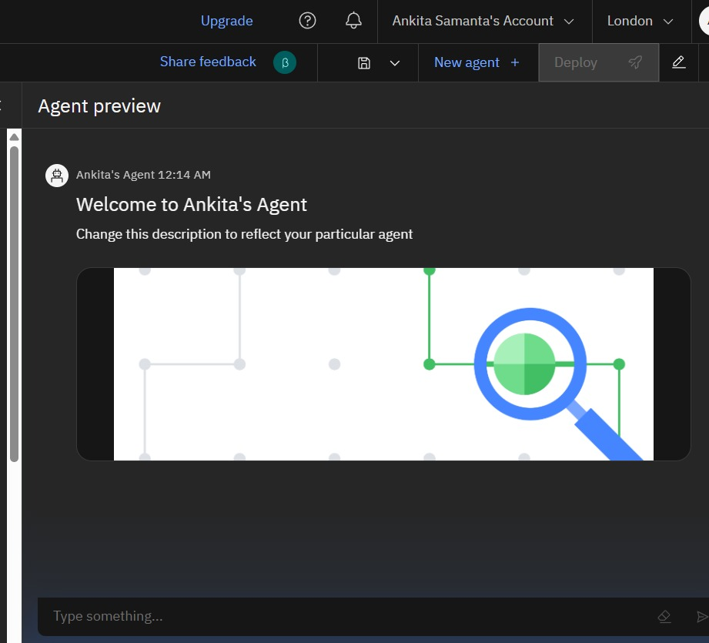
Results

Slide 9
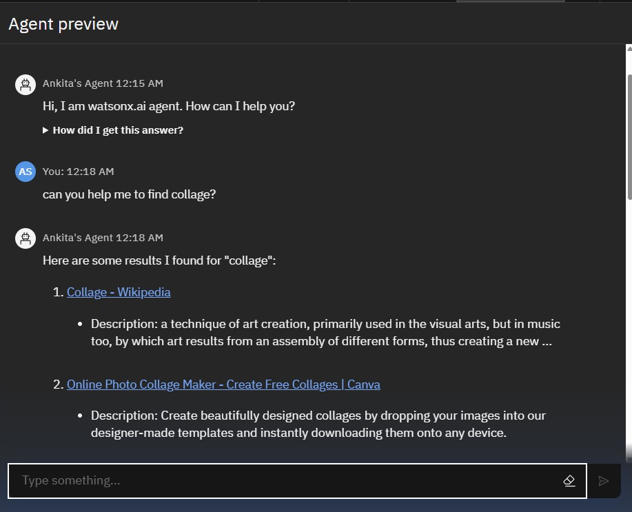
Results

Slide 10
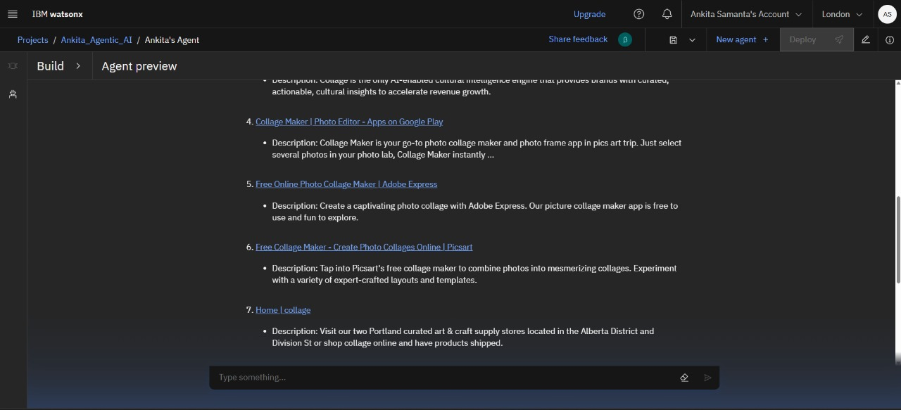
Results

Slide 11
Results

Slide 12
Conclusion
The College Admission Agent project successfully demonstrates how IBM Cloud services and Watson AI technologies can be integrated to build an intelligent, automated, and user-friendly admission system.
By combining AI-powered chatbots (Watson Assistant), cloud-based storage and backend (IBM Cloud Functions, Object Storage, Cloudant), and advanced features like sentiment analysis, multilingual support, and smart document handling, the system enhances both the student experience and the college administration process.

Slide 13
GitHub Link
https://github.com/ankitalipi2003/IBM_AI_AGENT_PROJECT

Slide 14
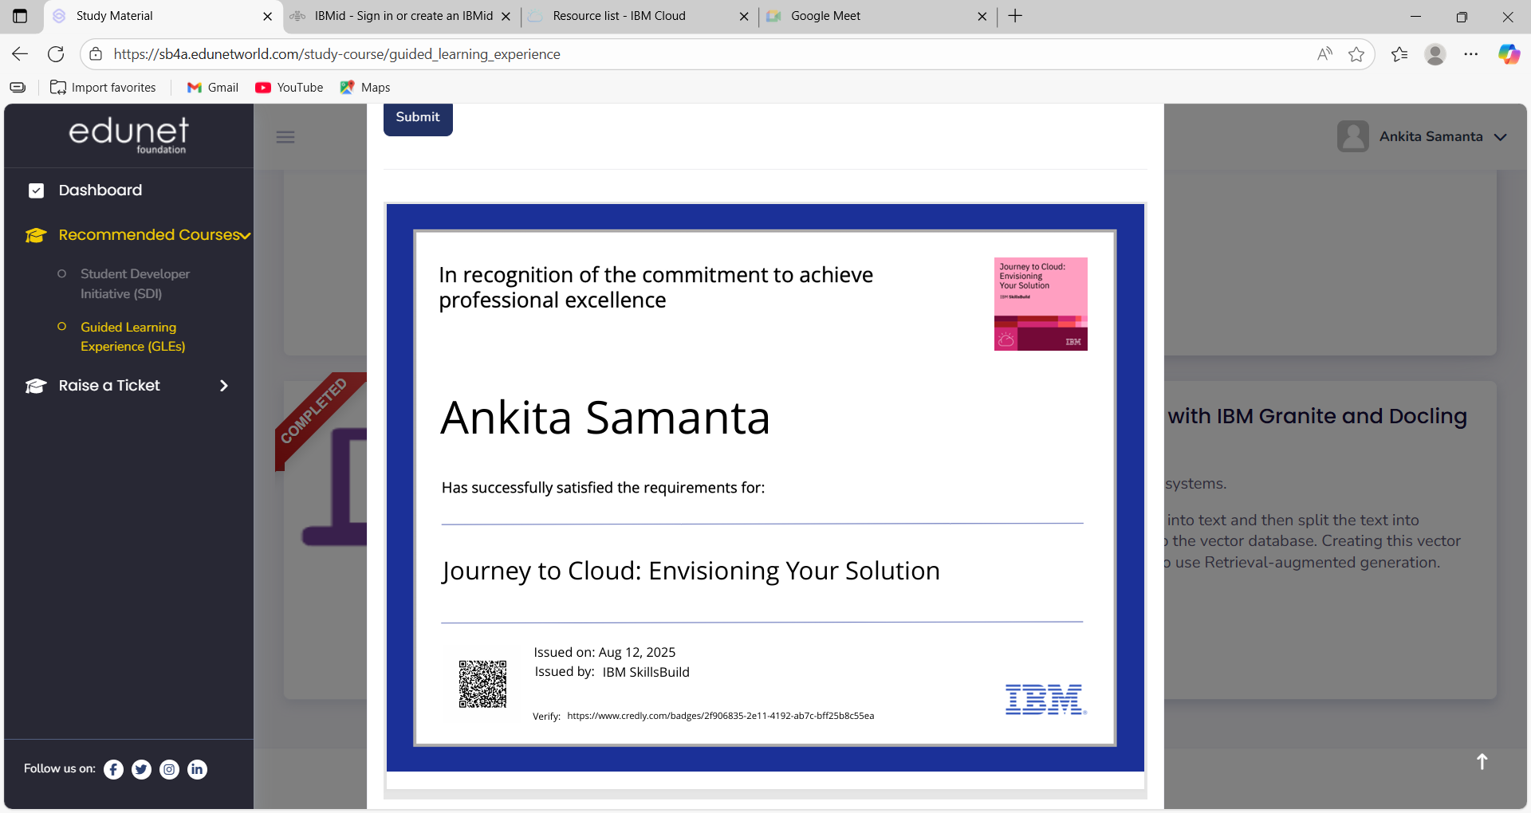
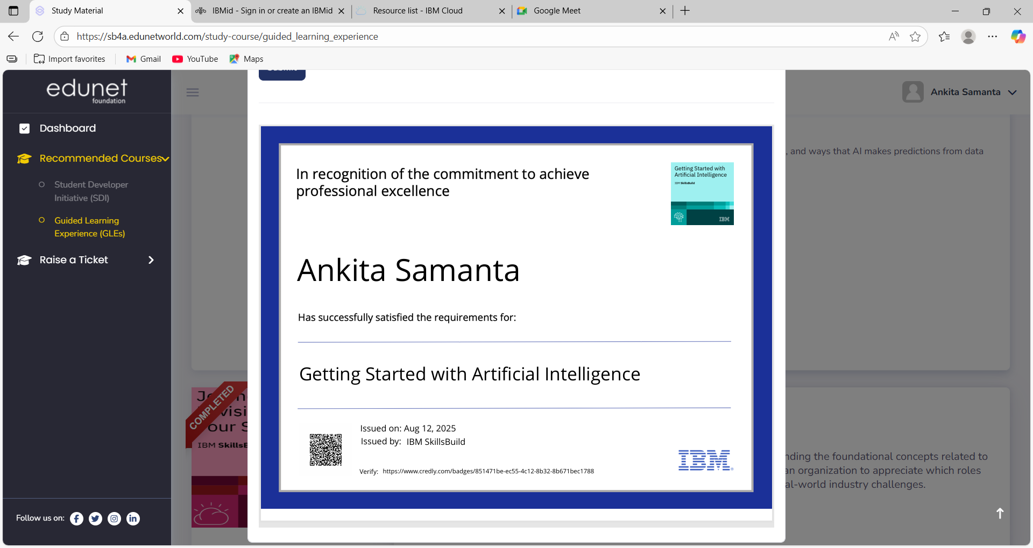
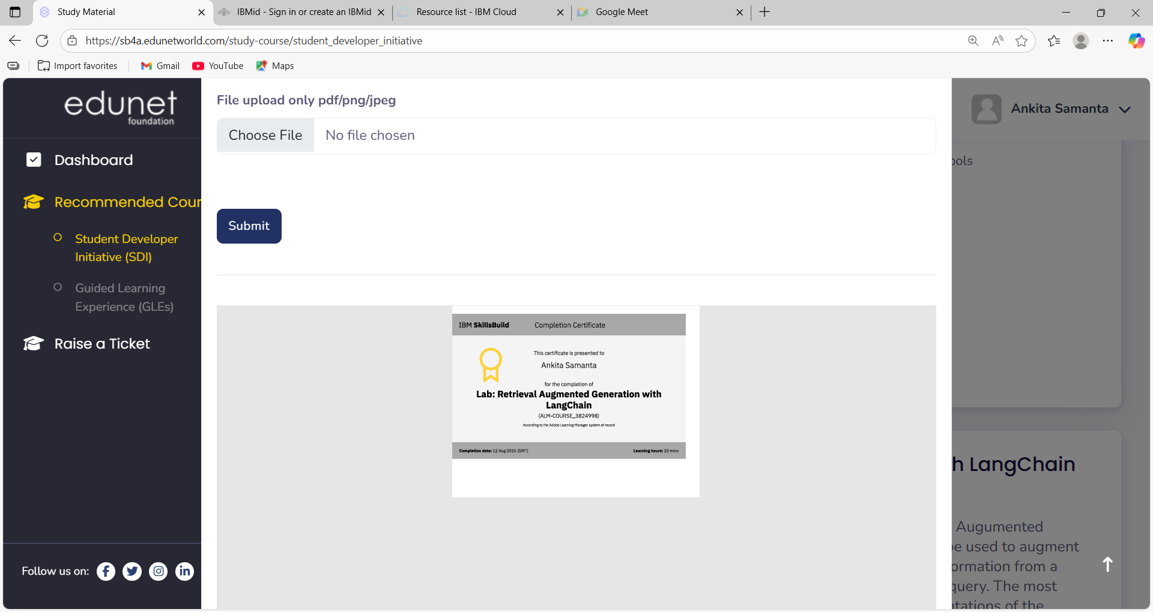
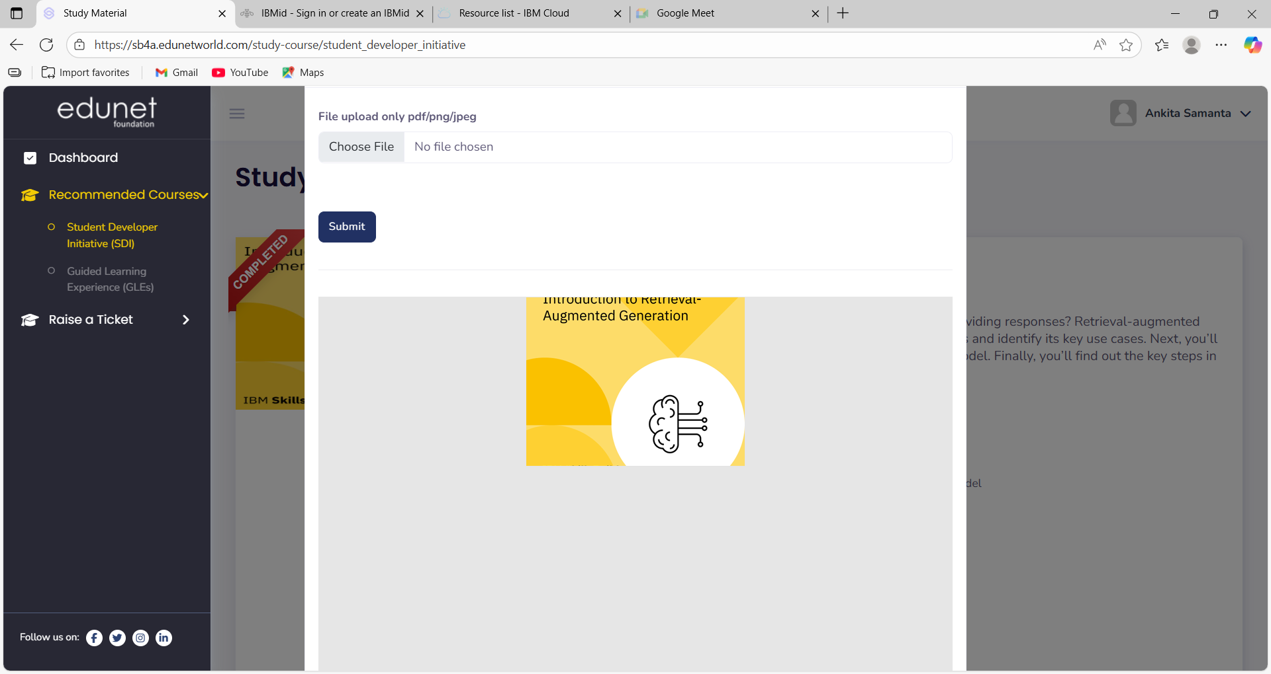
IBM Certifications
Screenshot/ credly certificate( getting started with AI)

Slide 15
Future scope
Mobile app integration for students and admins
Voice assistant support using Watson Speech services
Blockchain-based certificate verification
AI-powered personalized course recommendations
Integration with university ERP systems
Multilingual expansion with regional and global languages
Real-time analytics and predictive insights for admins
Self-learning chatbot using Watson Discovery and ML

Slide 16
THANK YOU

